Slide 1
Preservation of Software-based Art at Tate
By Patrícia Falcão, 2017.
Presented by Roxana Pena Mendieta

Slide 2
Artwork preservation means preserving both their experience and their technical history.
This paper describes the current understanding of software-based art preservation in the context of contemporary art in museums as well as the main strategies being tested and developed in the field.
It describes the role of the conservator and the lifecycle of the artwork.
It defines « intervention » as any action that changes the materials of an artwork, both hardware and software.

Slide 3
Why software-based art is difficult to preserve
Software is one of the primary media of the artwork.
The work often only exists when hardware, software, data, and display specifications function together. Obsolescence is built in: operating systems, peripherals, ports, APIs, and file formats keep changing. Then, conservation must preserve both meaning and functionality.
Hardware
Software
Data
Display context

Slide 4
Tate: useful test study
This museum is an example of an institutional problem, where is not fixing one artwork, is fixing many artworks for a long term.
2003: They acquired their first software-based artwork.
2017: ~650 total artworks, 35 per year, a team of 12 specialists.
Today: Ongoing ….

Slide 5
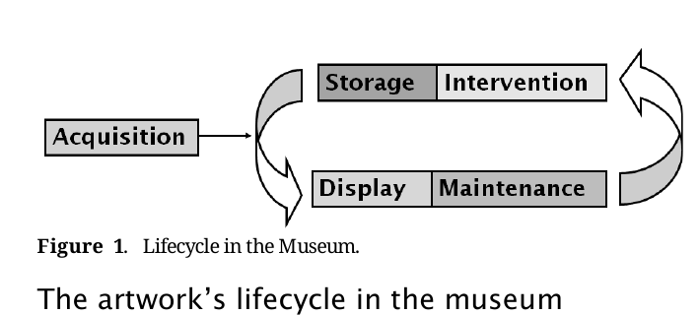
The artwork lifecycle in the museum
1. Acquisition: Gather components, artist input, technical analysis, and create a preservation plan.
2. Display and maintenance: Test the work in real conditions and document adjustments, faults, and decisions.
3. Storage: Keep both physical components and digital files, including historical systems, for the long term.
4. Intervention: Change hardware or software when needed to keep the work displayable.
Key idea: preservation is continuous. Display, storage and intervention all feed back into future decisions.

Slide 6
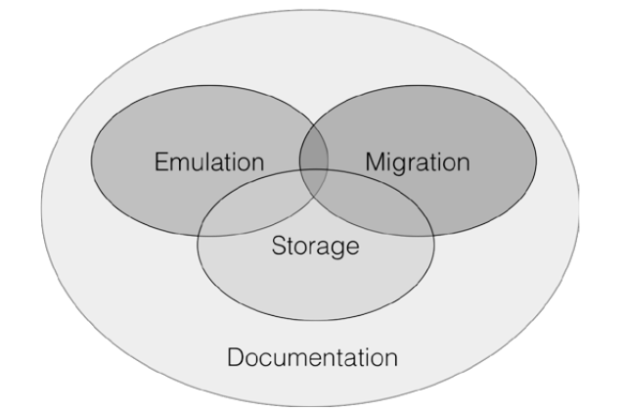
Main preservation strategies
Examples from the paper
Create exact disk images first, so analysis happens on copies rather than on the original computer. Store digital files in multiple copies and locations, with monitoring and retrieval workflows. Migrate systems when needed, for example, adapting a work from obsolete parallel-port printers to USB printers.
Prepare future emulation, for example, asking for a Windows version of a Unity artwork to avoid MacOS limitations later.
Notes:
Documentation: To avoid making the same mistakes.
record of the materials that compose an artwork, the artwork’s production processes, information about past and present displays and any interventions that may have changed them.

Slide 7
Storage
Any hardware and objects supplied as part of an artwork are kept and stored under the appropriate environmental conditions, and adequate packing is designed to keep those elements.

Slide 8
Intervention: Migration, emulation and anything else that helps.
Migrating a system to new hardware.
Migrating a piece of software to a more recent version.
Completely rewriting a piece of software.
Running the original software on emulators.

Slide 9
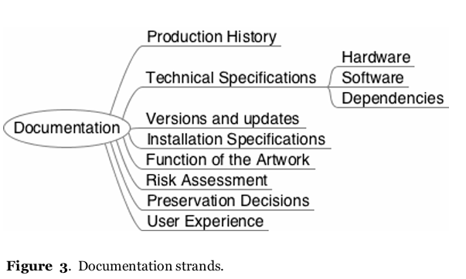
Documentation
Documentation: To avoid making the same mistakes.
Record of the materials that compose an artwork, the artwork’s production processes, information about past and present displays and any interventions that may have changed them.
Notes:
Documentation: To avoid making the same mistakes.
record of the materials that compose an artwork, the artwork’s production processes, information about past and present displays and any interventions that may have changed them.

Slide 10
Conclusion
Preservation is an ongoing, negotiated process
1- Preservation is proactive: Intervention can happen early, not only after a failure.
2- Documentation is critical: Without records, technical history disappears fast.
3- Collaboration: Artists, programmers, curators and conservators shape sustainable care.
From the paper: “Preserving software-based art is not about freezing technology in time, but about managing change without losing the artwork’s meaning.”

